Slide 1
Creating a Risk Assessment Template.
PLEASE NOTE ANY CHANGES TO WORDING, GHOST TEXT, ORDER OF QUESTIONS ETC SHOULD BE MIRRORED IN THE ACTUAL RISK ASSESSMENT PROCESS AND PREVIEWS

Slide 2
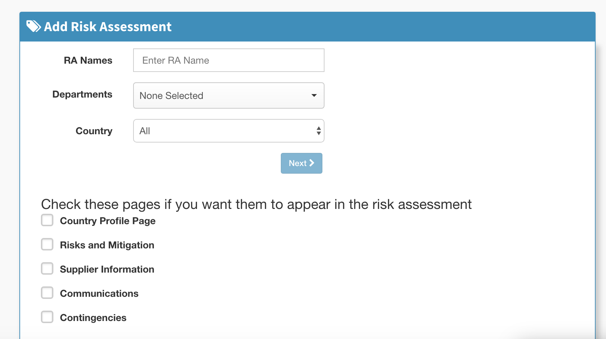
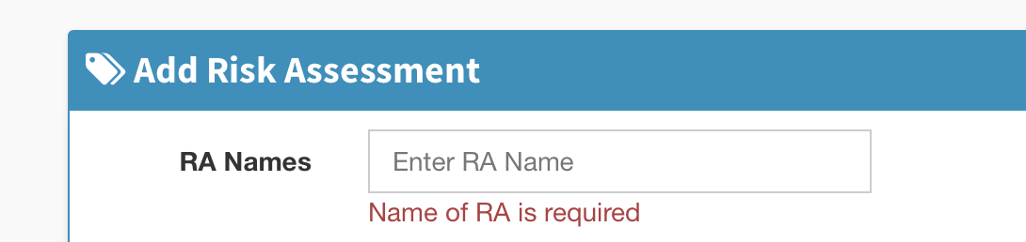
Change to field and ghost text to Template Name.
When not populated, change red text to Template Name required

Slide 3
change text to Select the sections that you want to appear in the risk assessment
Add one addition space between this sentence and Country Profile Page

Slide 4
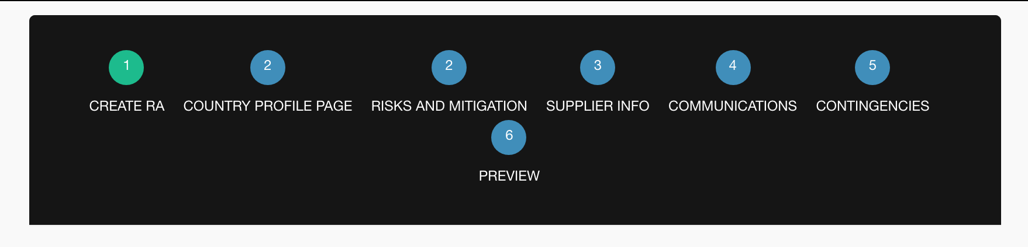
Country profile page and risks and mitigation share the same breadcrumb number. Should be numerical order

Slide 5
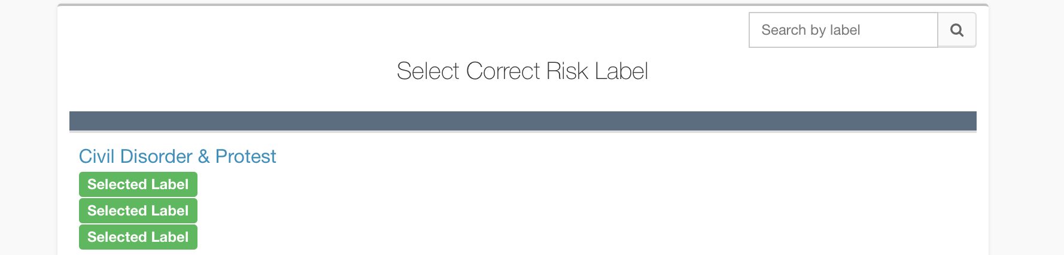
change to Search
change to Select Risk Labels

Slide 6
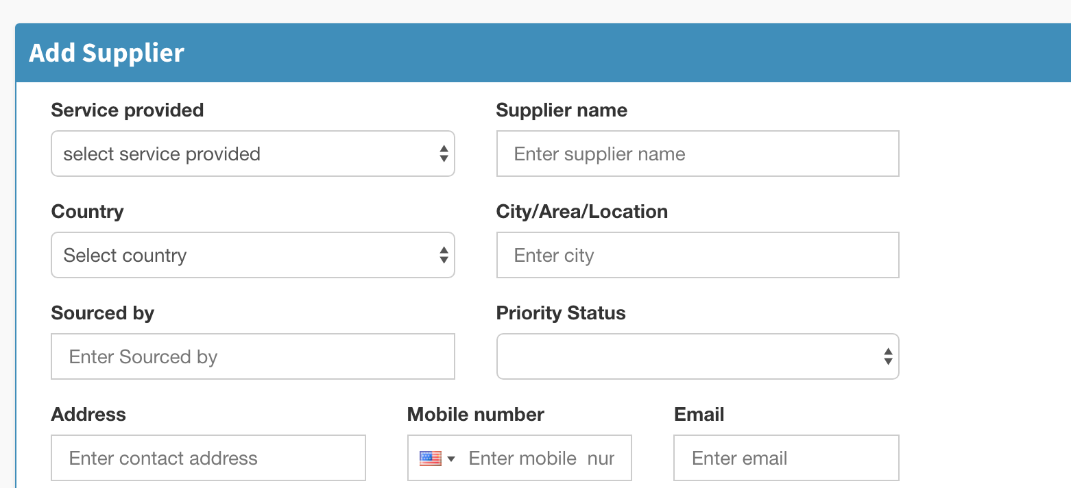
Breadcrumb 4: for each field.
Capitalisation needed on each new word
Make the ghost text match the field title (remove “select” and “Enter”)

Slide 7
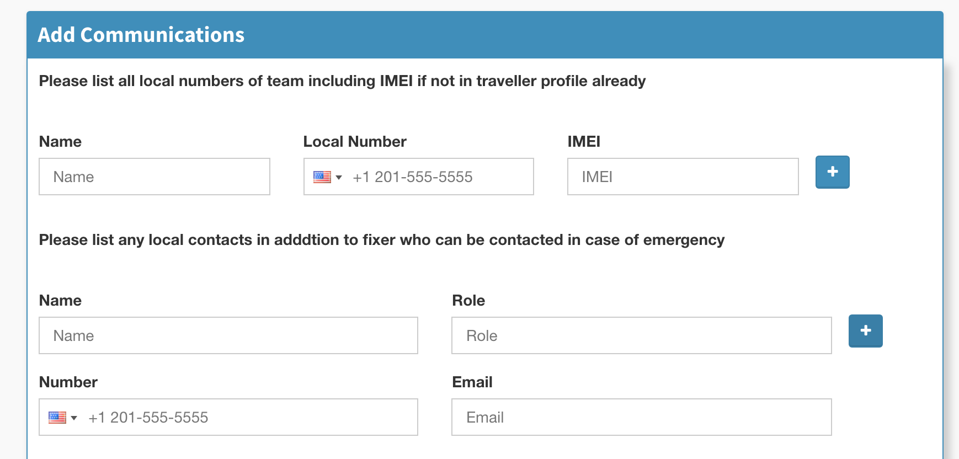
Breadcrumb 5. the ghost text numbers should not show as its misleading to user
change top field text to ‘List additional local numbers’
change bottom question to ‘List any additional local emergency contacts’

Slide 8
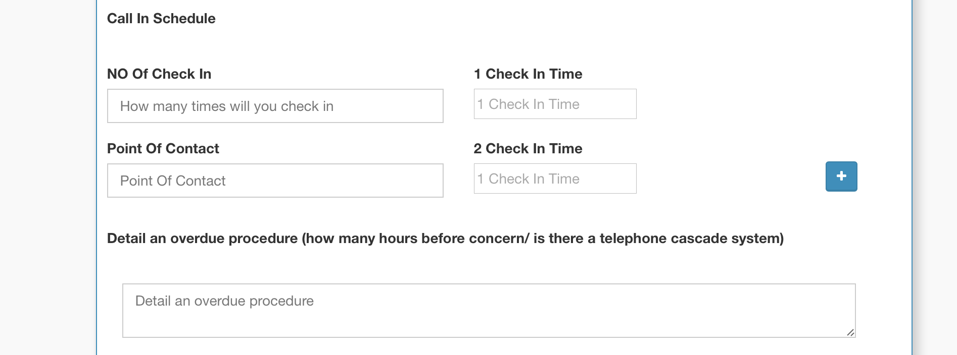
Following text changes (in descending order): 1) Check-in schedule
2) No. of Check-ins 3) Point of Contact 4) Check-in time 1, Check-in Time 2
5) Overdue procedure (minutes/hours before concern; telephone cascade plan) 6) Overdue procedure

Slide 9
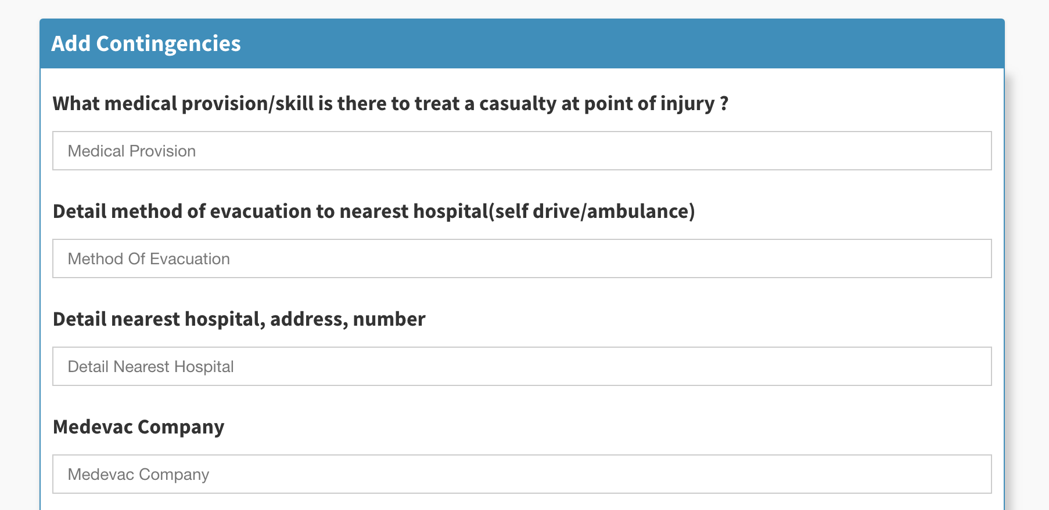
Breadcrumb 6. in descending order:
1) remove space before question mark. 2) change text to Method of evacuation to nearest hospital (self drive/ambulance etc). (Add space before bracket). 3) Method of evacuation (capitalisation) 4) change text to: Local hospital information 5) change text to: Medical Evacuation Company
can you change the order of these two questions both here and in the risk assessment process? Change should also be reflected in preview and PDF

Slide 10
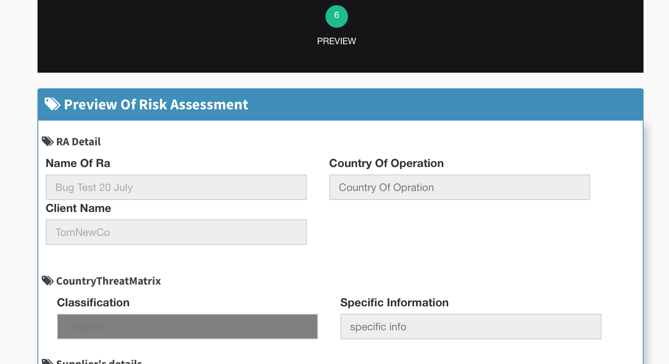
Breadcrumb 6) Preview. All fields already changed should of course carry across to the preview. Ghost text from unanswered fields should not carry across to the preview or PDF.
When a template is not country specific it should not carry the country-specific fields into the template. As a minimum, change typo on Opration in the Country of Operation box. Specific Information box should be removed.

Slide 11
Breadcrumb 6. Preview
As well as the above, extensive changes are required throughout the template preview to reflect accurate section names, fields carrying across and changes in the preview already being made.

Slide 12
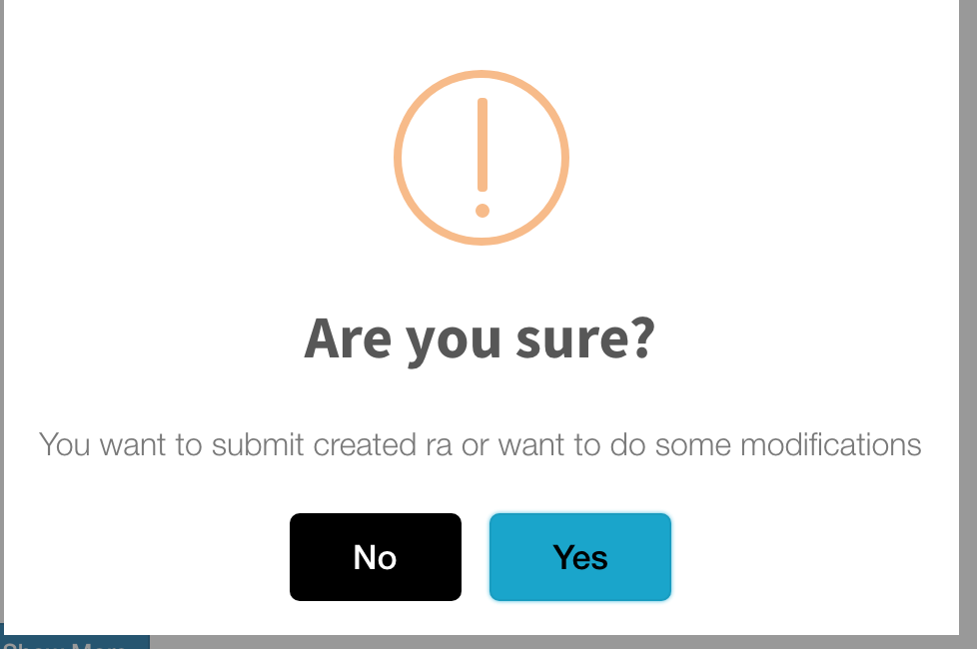
Change text to
Submit? (replacing Are you sure?)
Confirm submission of risk assessment (replacing smaller text)

Slide 13
Edit the Risk Assessment
All relevant field changes already listed should of course carry into the edit process.

Slide 14
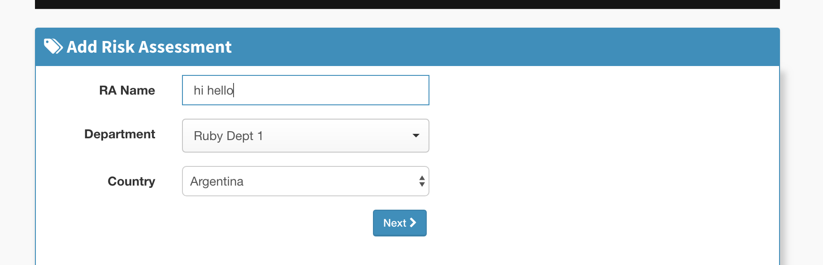
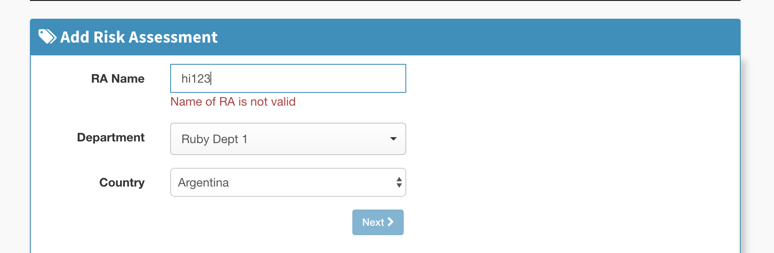
Editing RA Template – 1 RA name field is blank. 2) it will only let you use letters, it won’t let you add numbers.
NOTE: this only happens when you go back in and edit, it lets you add numbers if you do it from creating one at the start. BUT (SEE NEXT SLIDE)

Slide 15
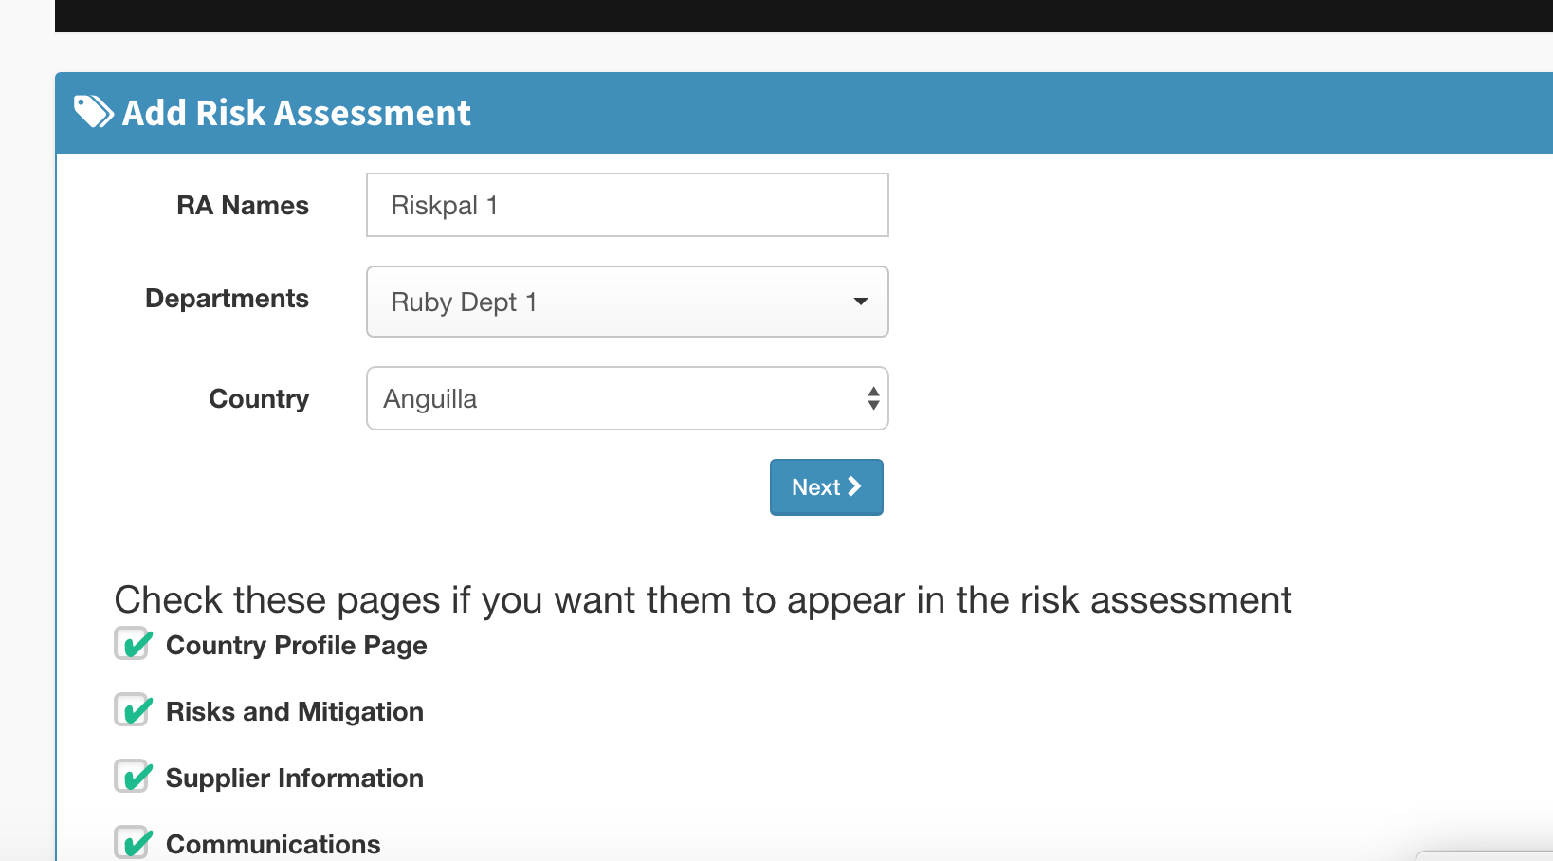
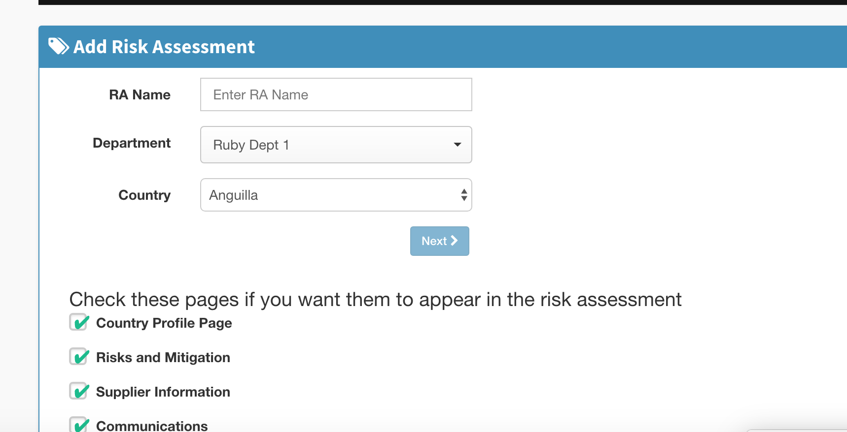
Using numbers in RA Name – RA Name is deleted when you go back and will not let you re-add the number.
Step 1: Enter RA Name with a number, e.g. ‘Riskpal 1’
Step 2: Click on to breadcrumb number 2, then click back on to breadcrumb number 1 – RA name has been deleted

Slide 16
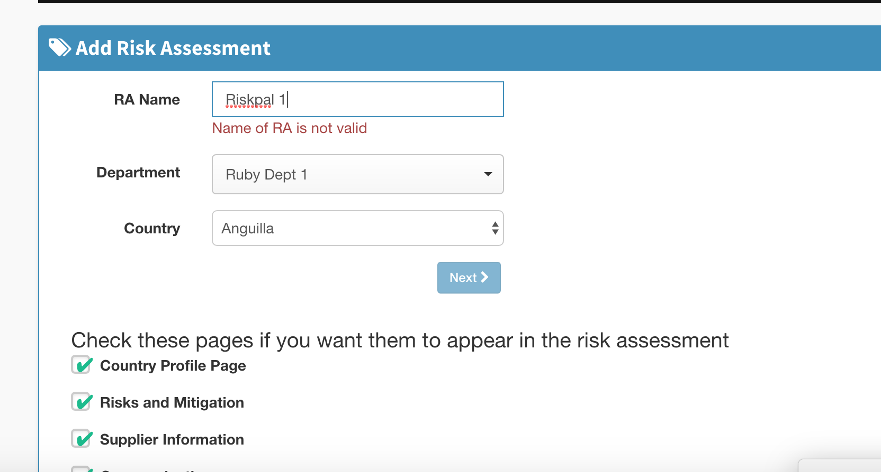
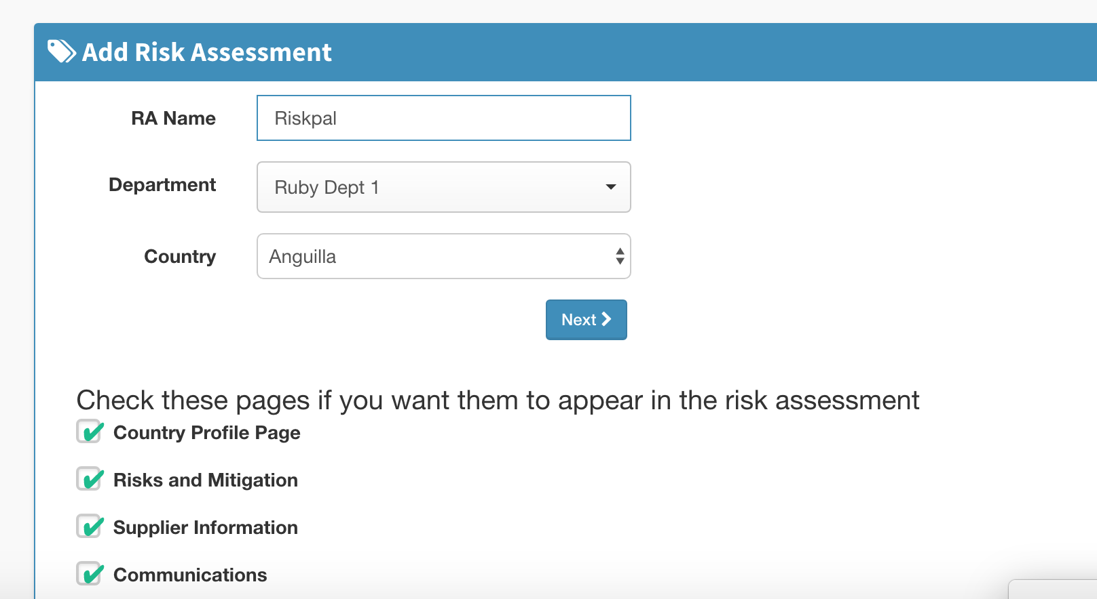
Continued
Step 3: Re-enter RA name as before with number – name of RA is not valid – this applies with any number not just the same number it was before
Step 4: Delete number, and RA Name is now valid

Slide 17
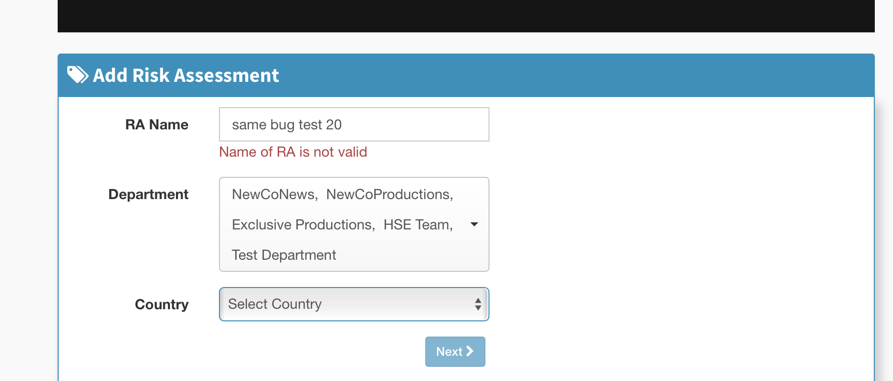
Editing RA Template –
All Countries option is not available. In the original All had been selected. When editing this is not an option.

Slide 18
Completing a risk assessment
NOTE. This does not include all the changes requested in the Create Template Process, many which should carry across

Slide 19
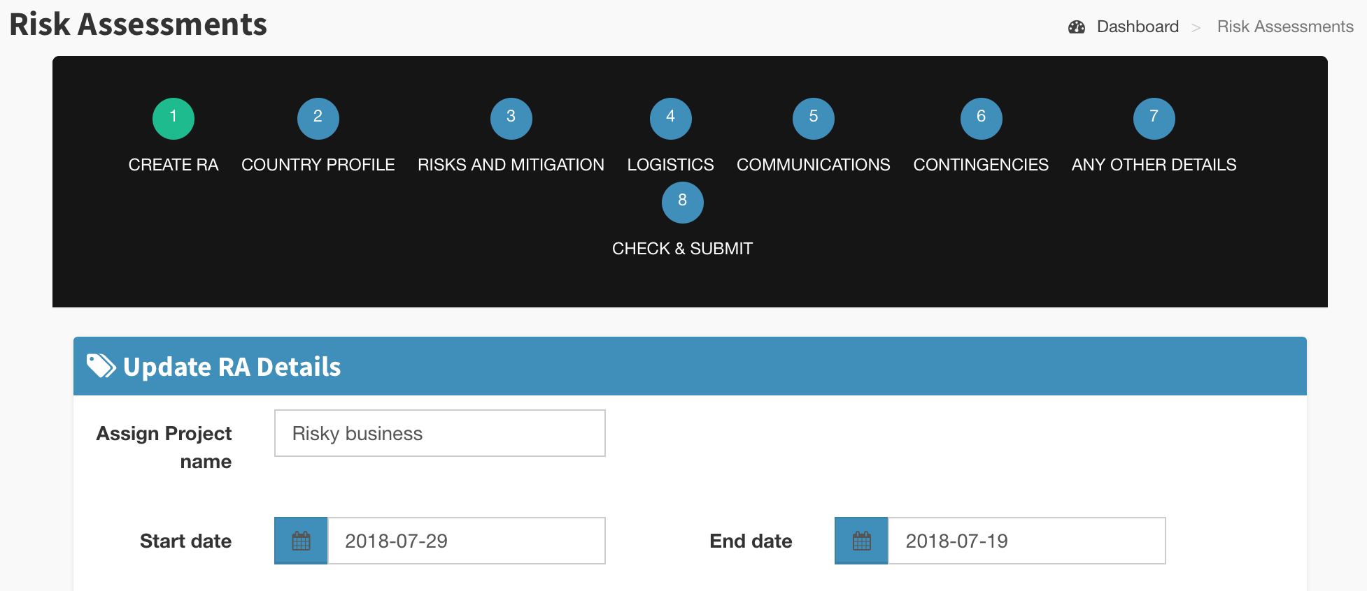
Breadcrumb 1 - End date before start date – needs a block

Slide 20
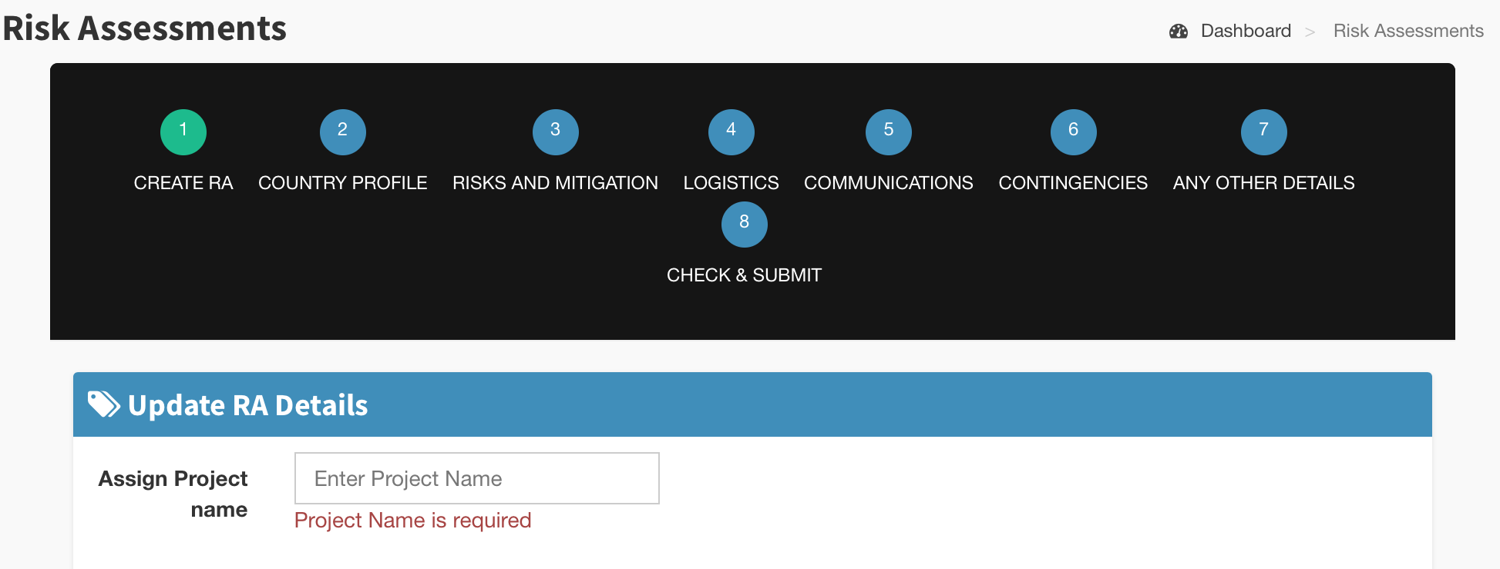
Breadcrumb 1 - Text and ghost text are different. Change both to Project Name

Slide 21
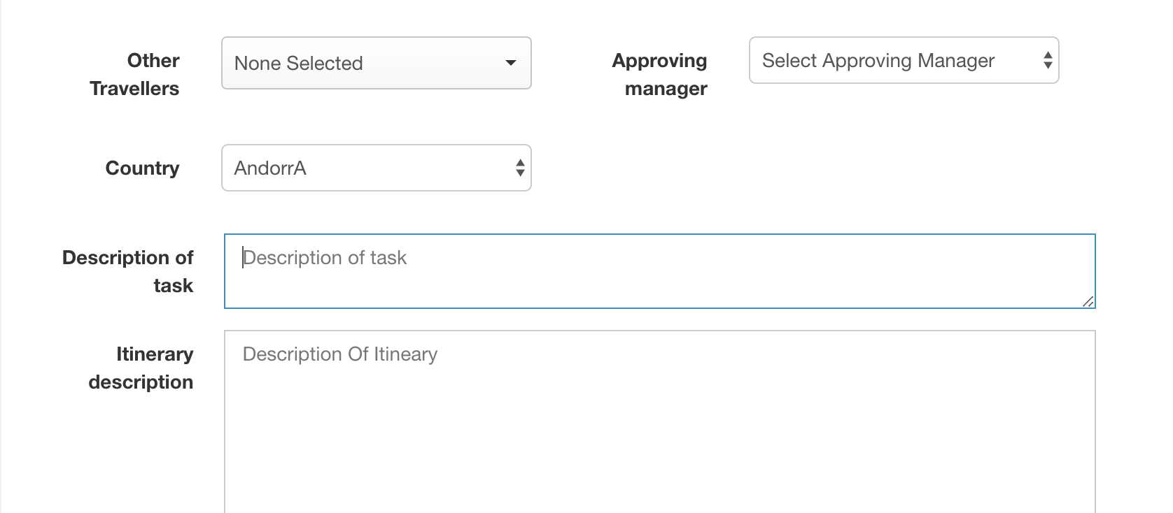
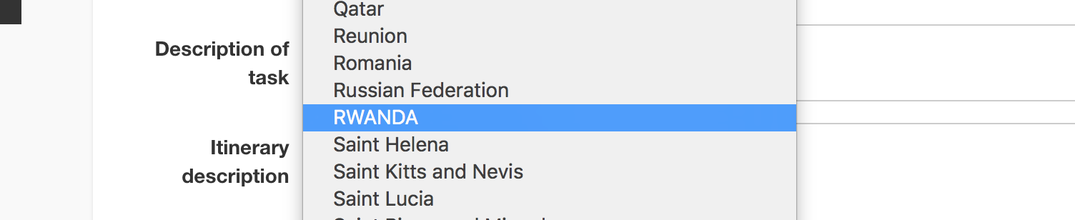
Breadcrumb 1 – Capitalise ‘Manager’. fix random capitalisation of AndorrA and RWANDA in country list. Rename description of task to Task Description.
capitalise Description in Itinerary field and match the ghost text

Slide 22
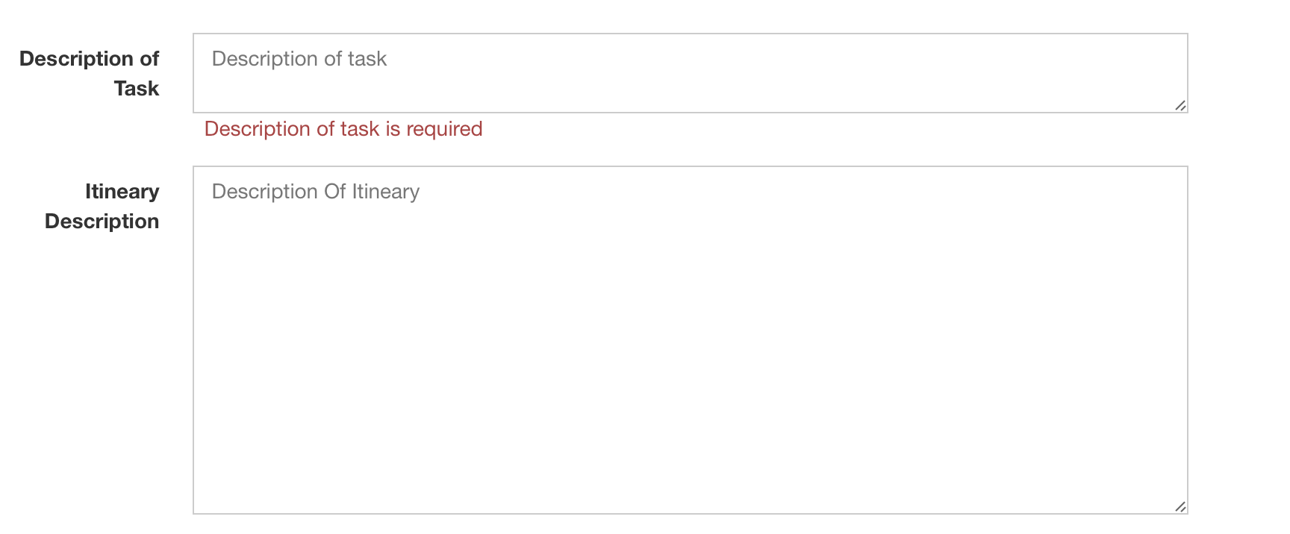
Breadcrumb 1 - spelling error – ‘itinerary’

Slide 23
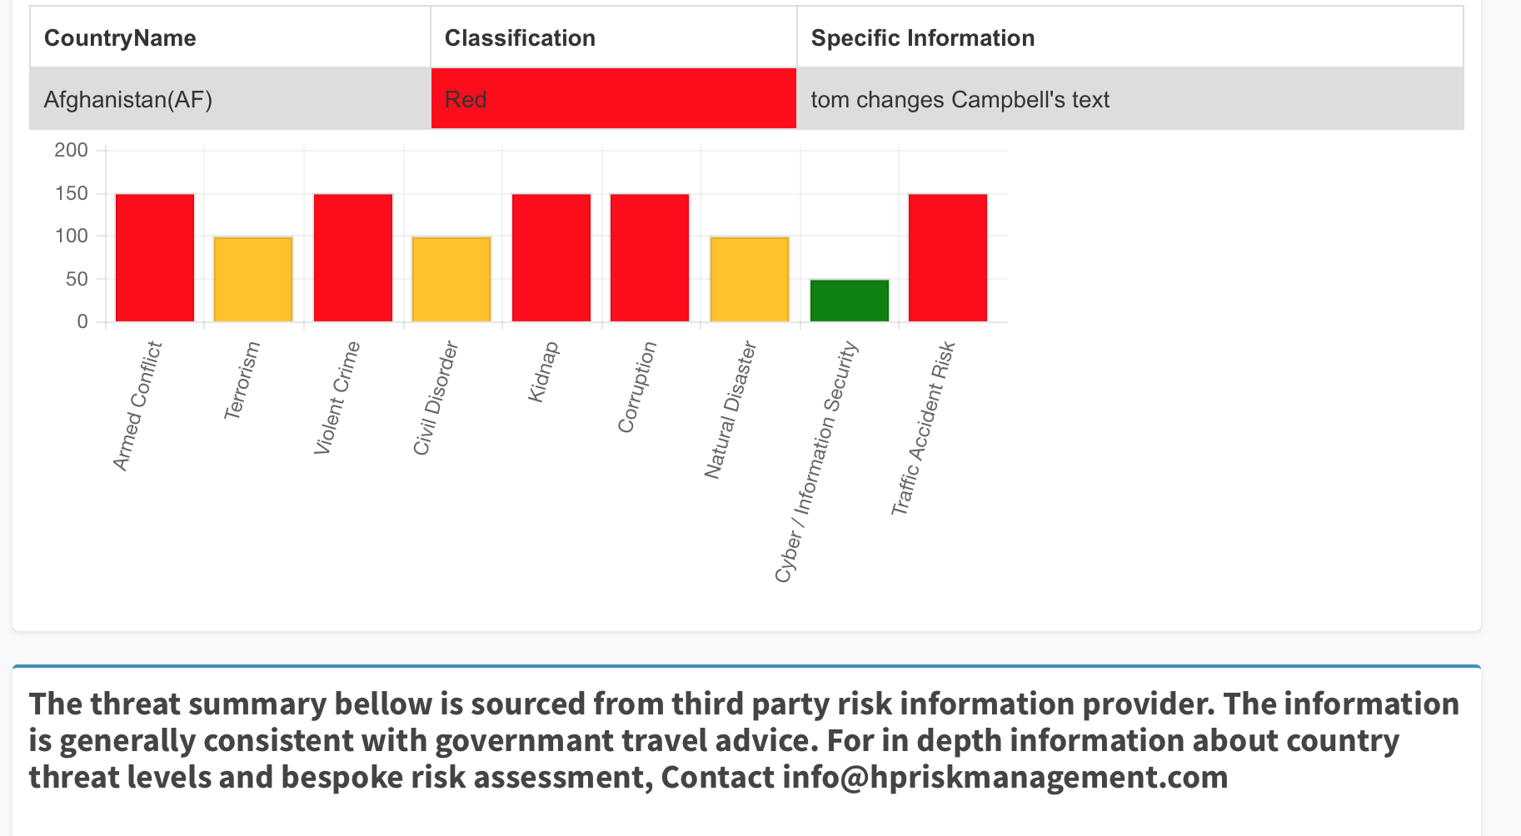
Breadcrumb 2 - Spelling error. ‘Bellow’ and ‘governmant’. Un-capitalise ‘contact’ and change ‘in depth’ to ‘in-depth’ note, this is coded text so should be editable

Slide 24
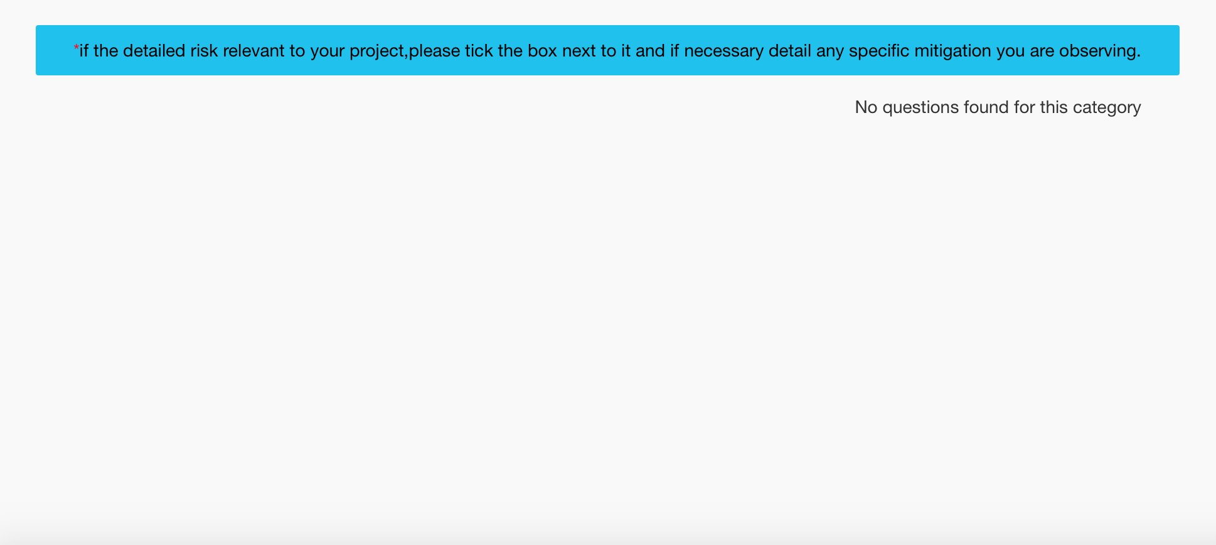
Breadcrumb 3 - change text in box to: Please select relevant risks by using the tick box on the right side of each question. Review the advice and add addtional measures that you will undertake during your trip.

Slide 25
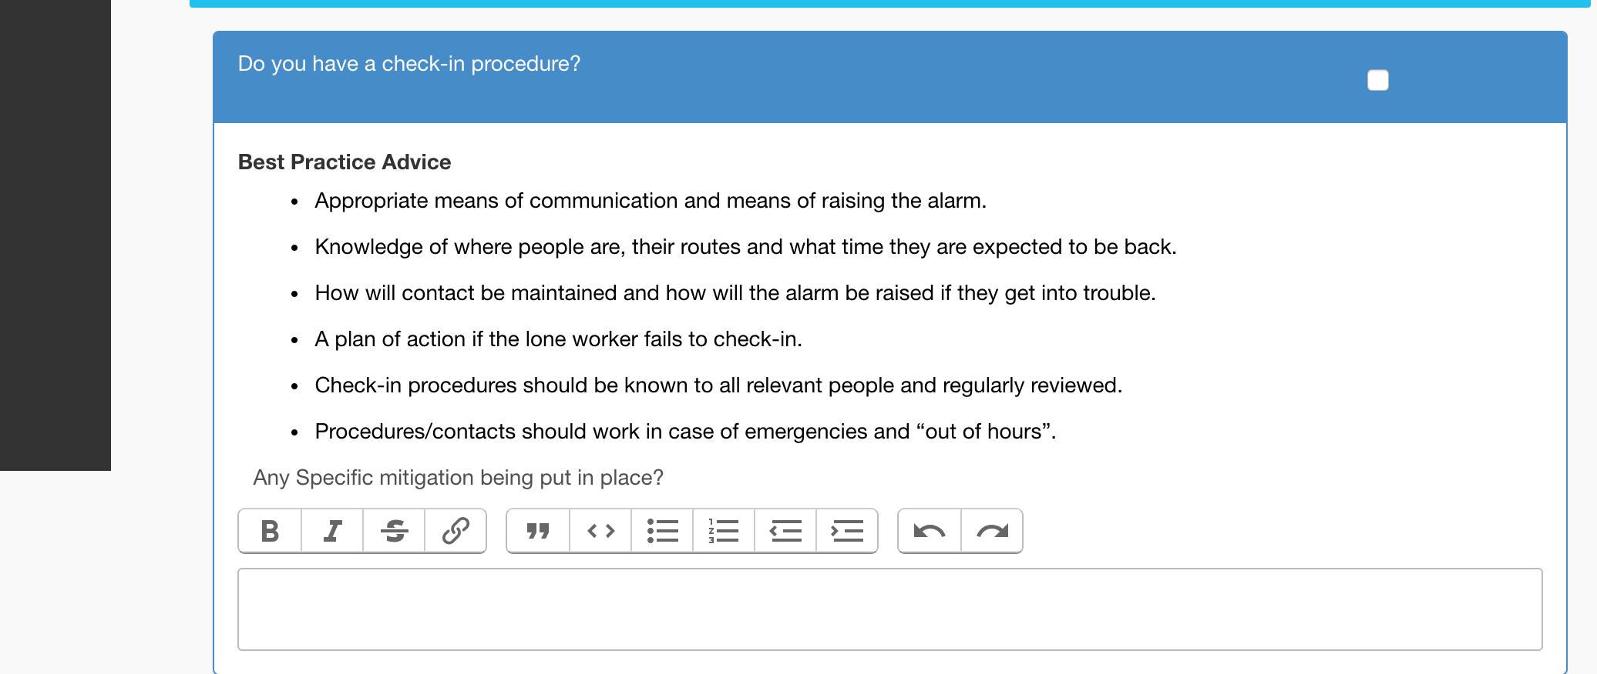
Breadcrumb 3 - 1) change Any Specific Mitigation being put in place? to ‘Additional Information / Specific Mitigation’ (please make it bold and also have the same ghost text fill the text boxes)
2) Delete the formatting boxes that appear in each question

Slide 26
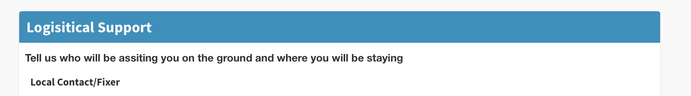
Breadcrumb 4 – spelling error ‘assisting’

Slide 27
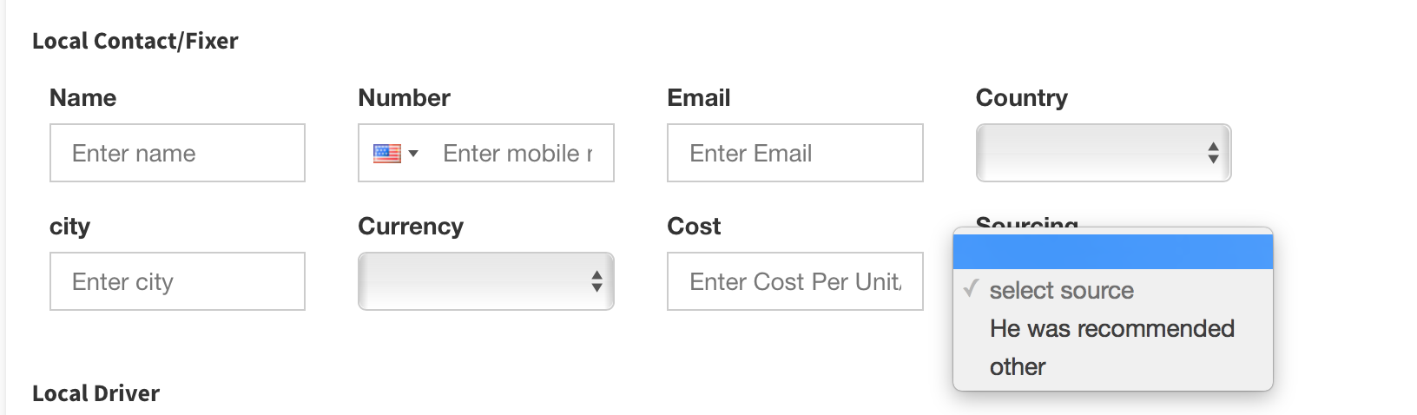
Breadcrumb 4 – change ‘He was recommended’ – to ‘Recommendation’ and capitalise ‘Other’?
Capitalise City. apply changes to all supplier boxes where these options appear

Slide 28
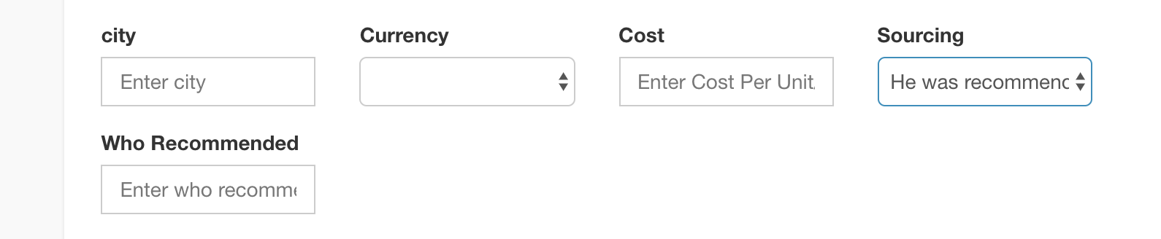
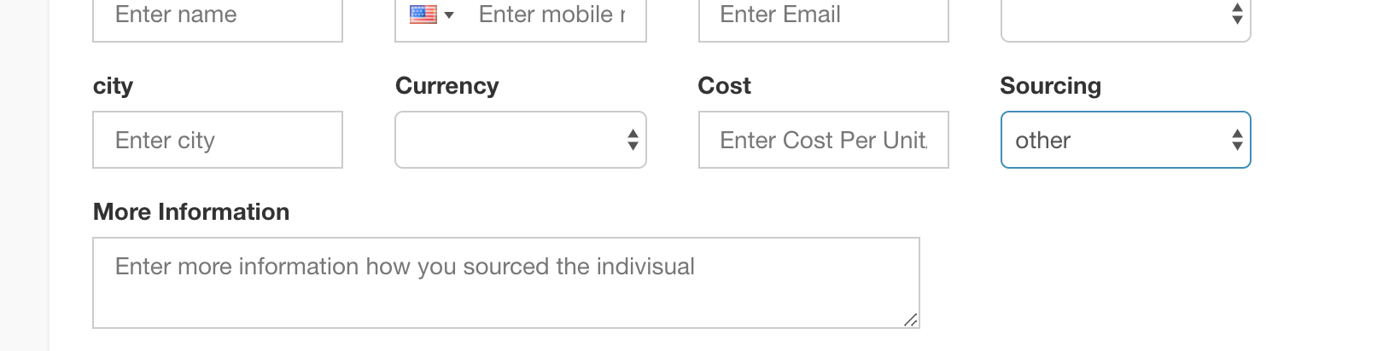
Breadcrumb 4 - when you select Recommendation (see previous slide) in Sourcing, this box appears; change text and ghost text to Recommended By.
When you select Other, keep the field title as ‘More Information’ but change ghost text to ‘Provide more information about how you sourced the supplier’

Slide 29
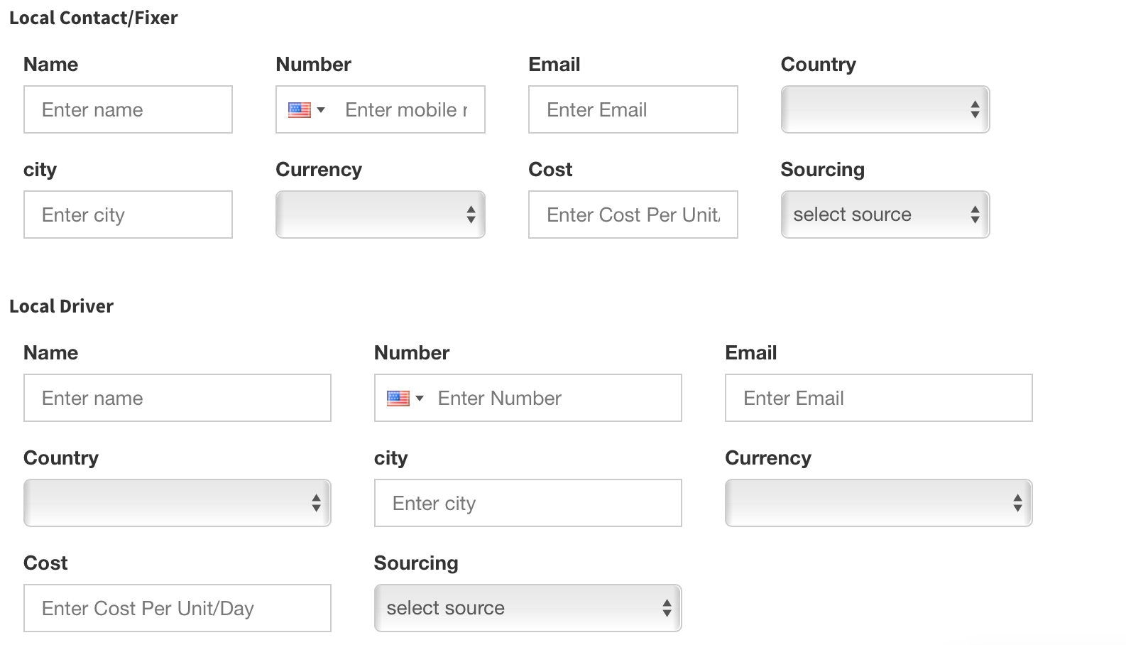
Ghost text doesn’t match - remove ‘mobile’ from the top box. Also size of boxes are different so each section looks different, e.g. four boxes on top line in first section, only three in second section - please format consistently

Slide 30
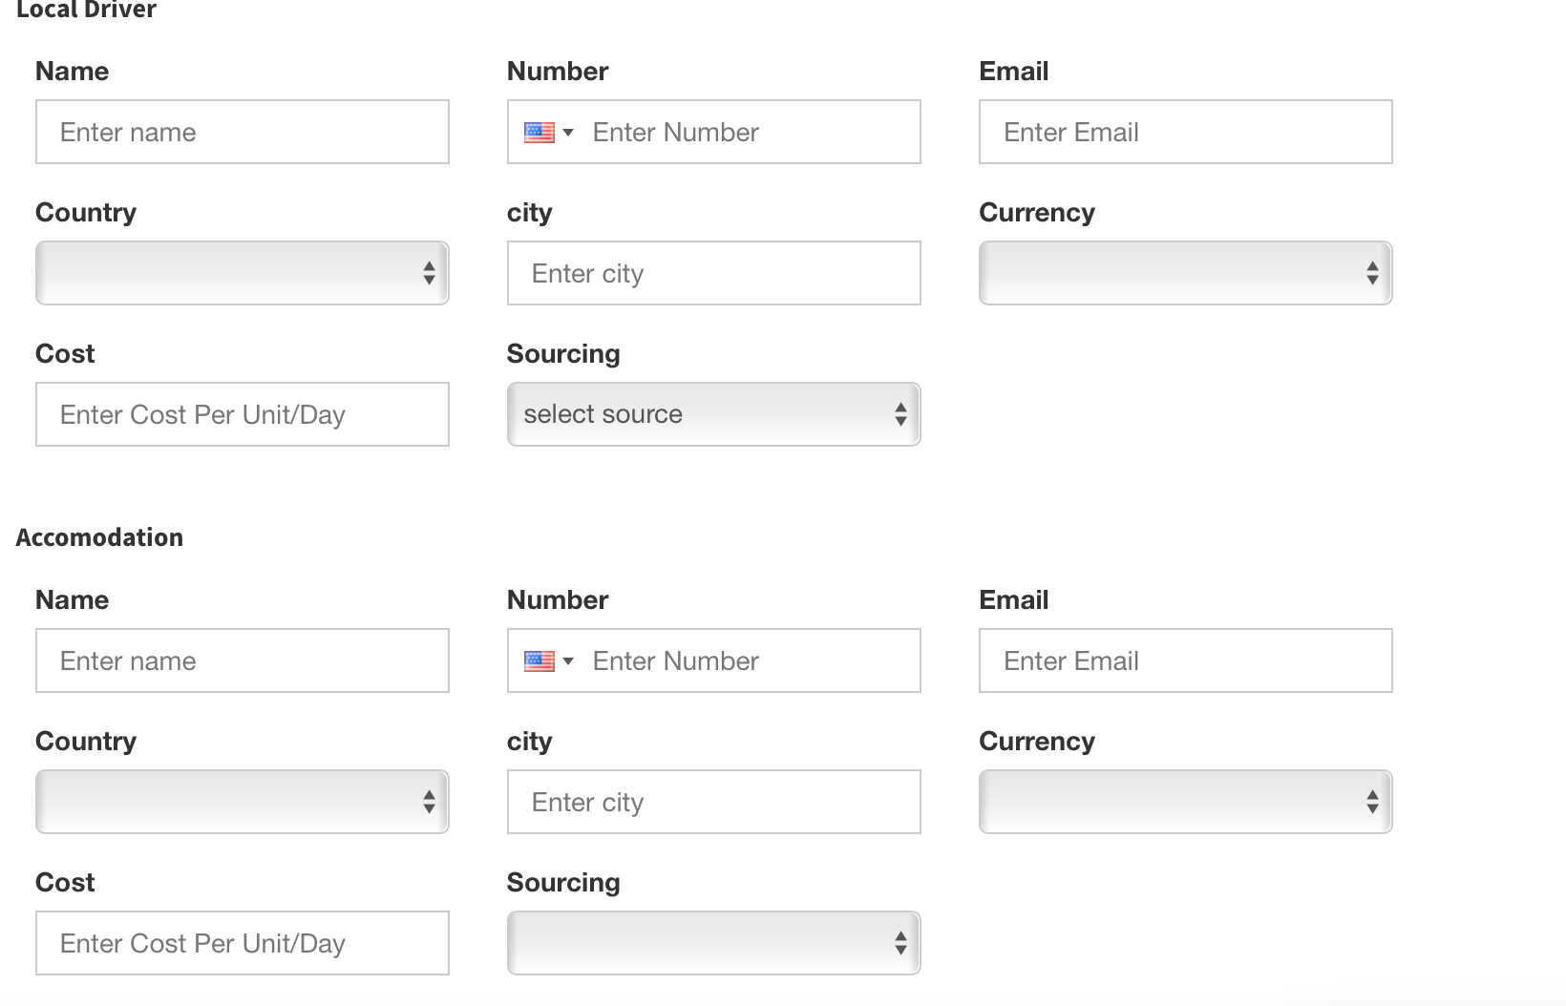
Breadcrumb 4 – Spelling error – ‘accommodation’ and earlier mentioned capitalisation needed
Ghost text doesn’t match

Slide 31
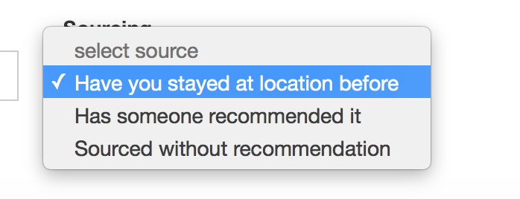
Breadcrumb 4 - Accommodation. change 3 options to Previous Stay / Recommendation / Other

Slide 32
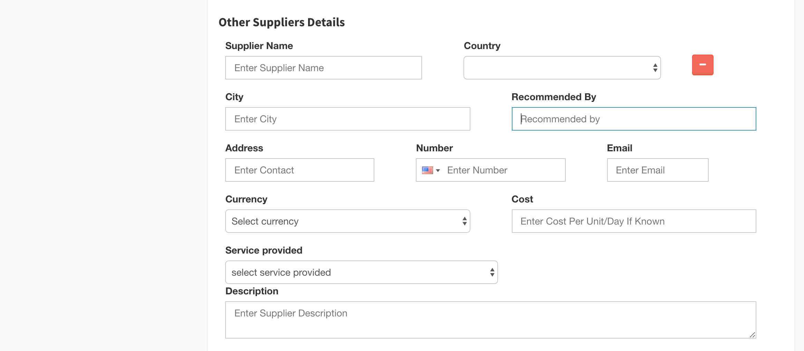
Breadcrumb 4 - chage boxes in descending order:
Other Suppliers Details. - Change title to ‘Additional Suppliers’
Recommended By box should be replaced with Sourcing and subsequent Recommended By / More Information box should be the options, like the other suppliers
Ghost text for Cost should read ‘Cost per unit/day if known’

Slide 33
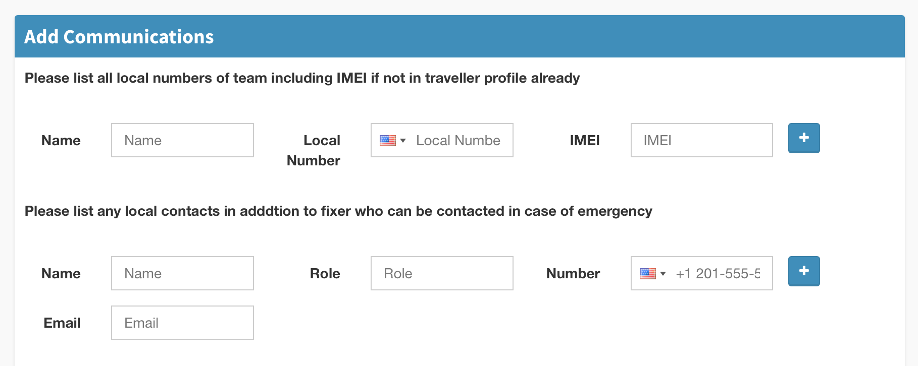
Breadcrumb 5 – number already input. Other changes already documented in template creation process

Slide 34
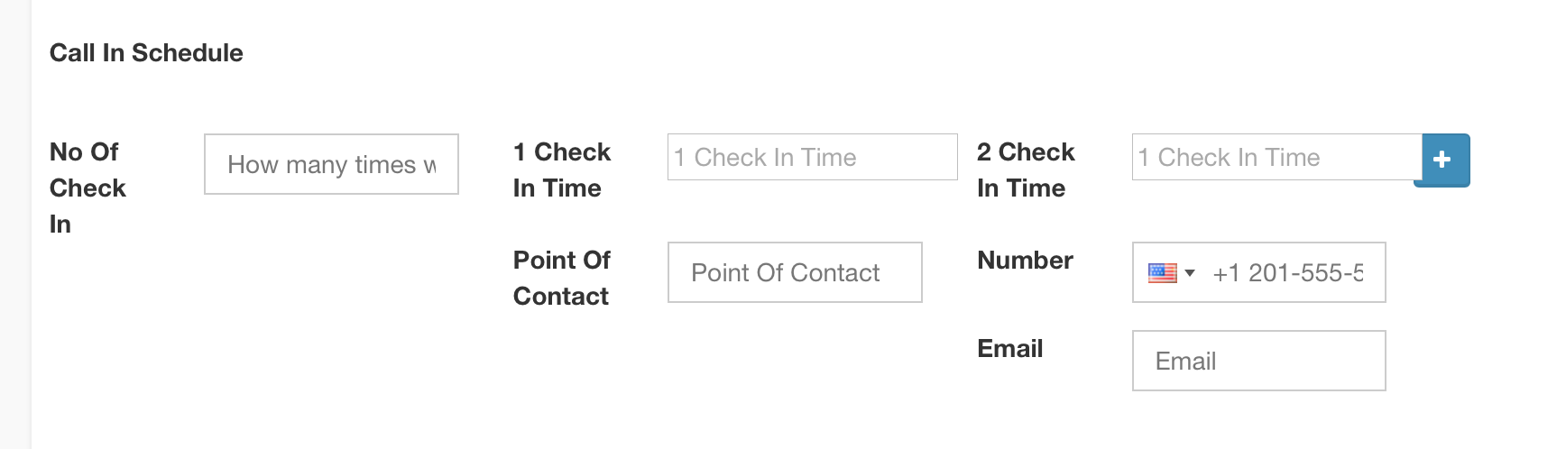
Breadcrumb 5 – formatting. 2 Check in time overlaps the plus button Also, ghost text on No. of Check In does not match the field title. Phone number is input already again

Slide 35
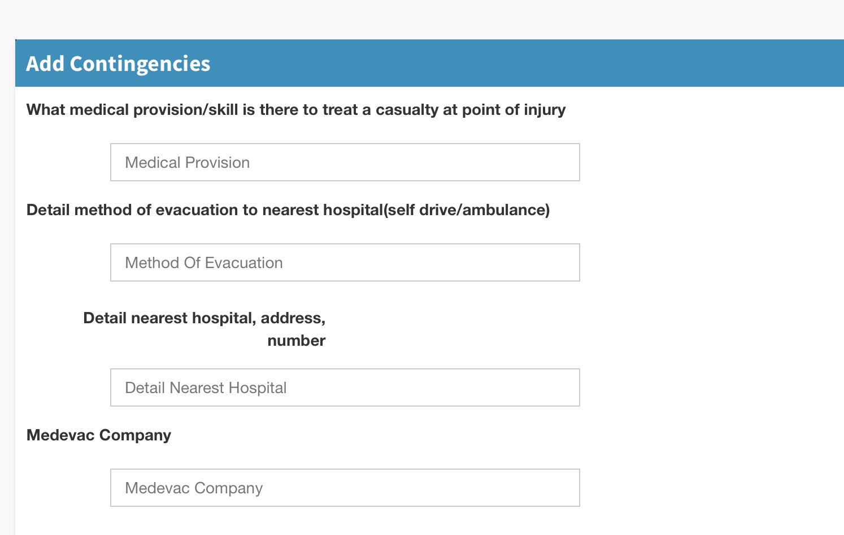
Breadcrumb 6 – weird formatting in box. have on a single line.

Slide 36
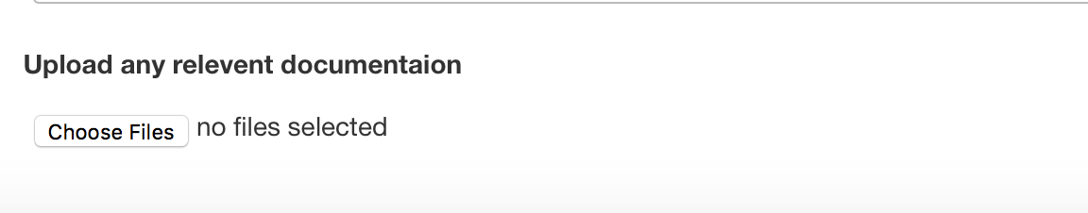
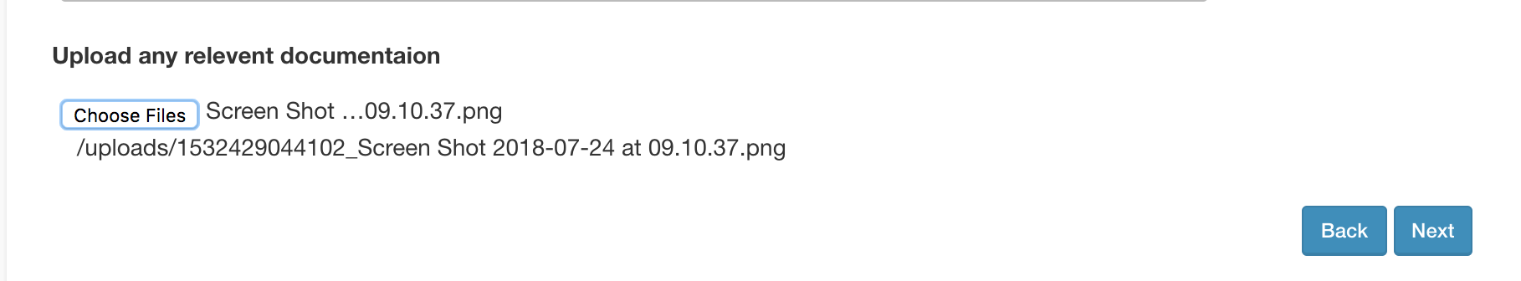
Breadcrumb 7 - Can’t upload Word documents, Video, Jpegs, XLS
change text to ‘Upload Supporting Information’
once you select a document, no obvious way to remove it

Slide 37
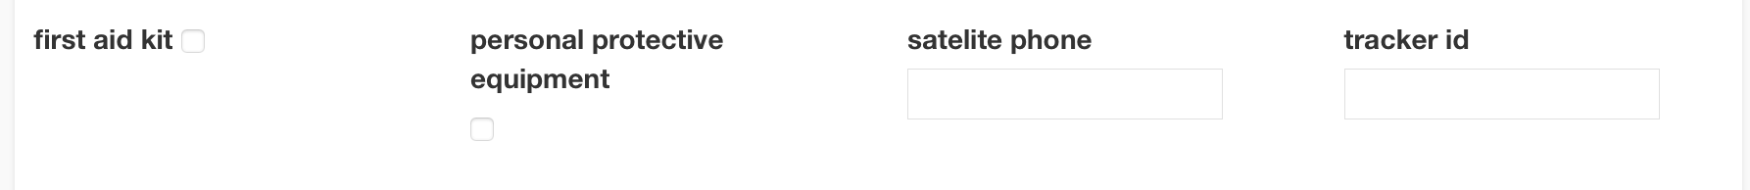
Breadcrumb 8 Check & Submit – need to capitalise each word

Slide 38
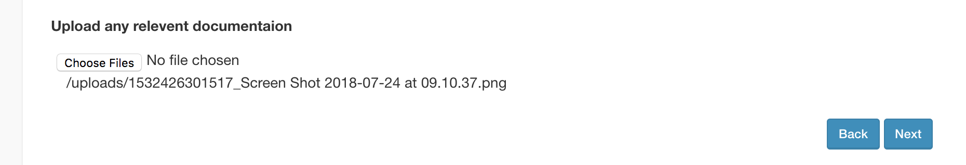
Traveller receives More Information Request:
see what traveller sees in Breadcrumb 7. there is no way for the traveller to remove the file.

Slide 39
Manager receives traveller’s Risk Assessment

Slide 40
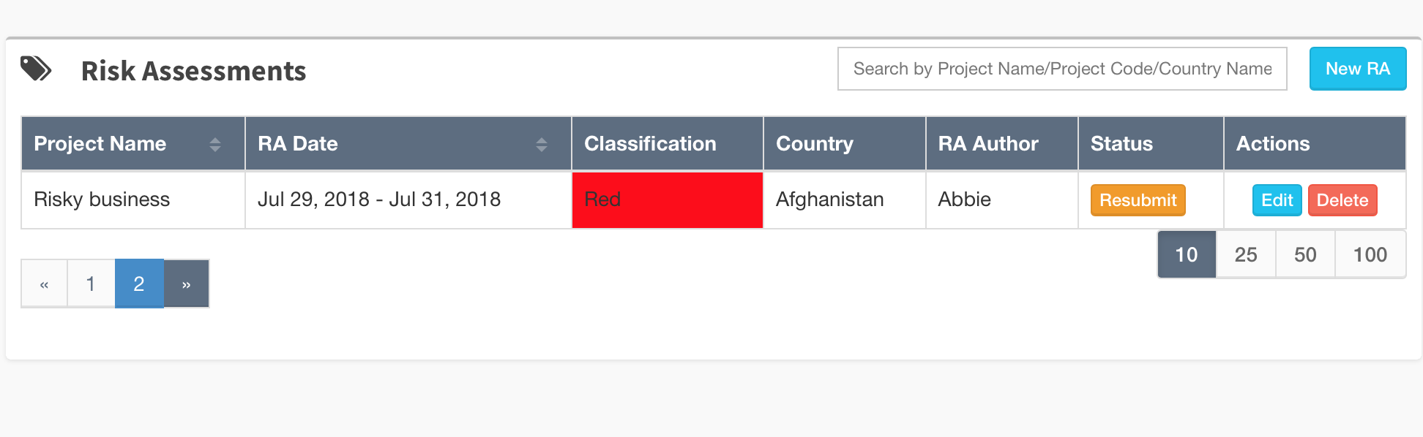
Traveler responding to request for more info – resubmit button is not responding – have tried on multiple different RA’s and none work

Slide 41
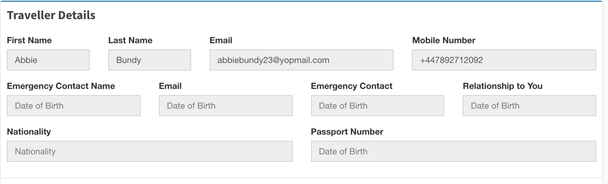
When a manager goes into a submitted RA for review/approval all traveller sections are showing Date of Birth. This might be fixed when you update the preview.

Slide 42
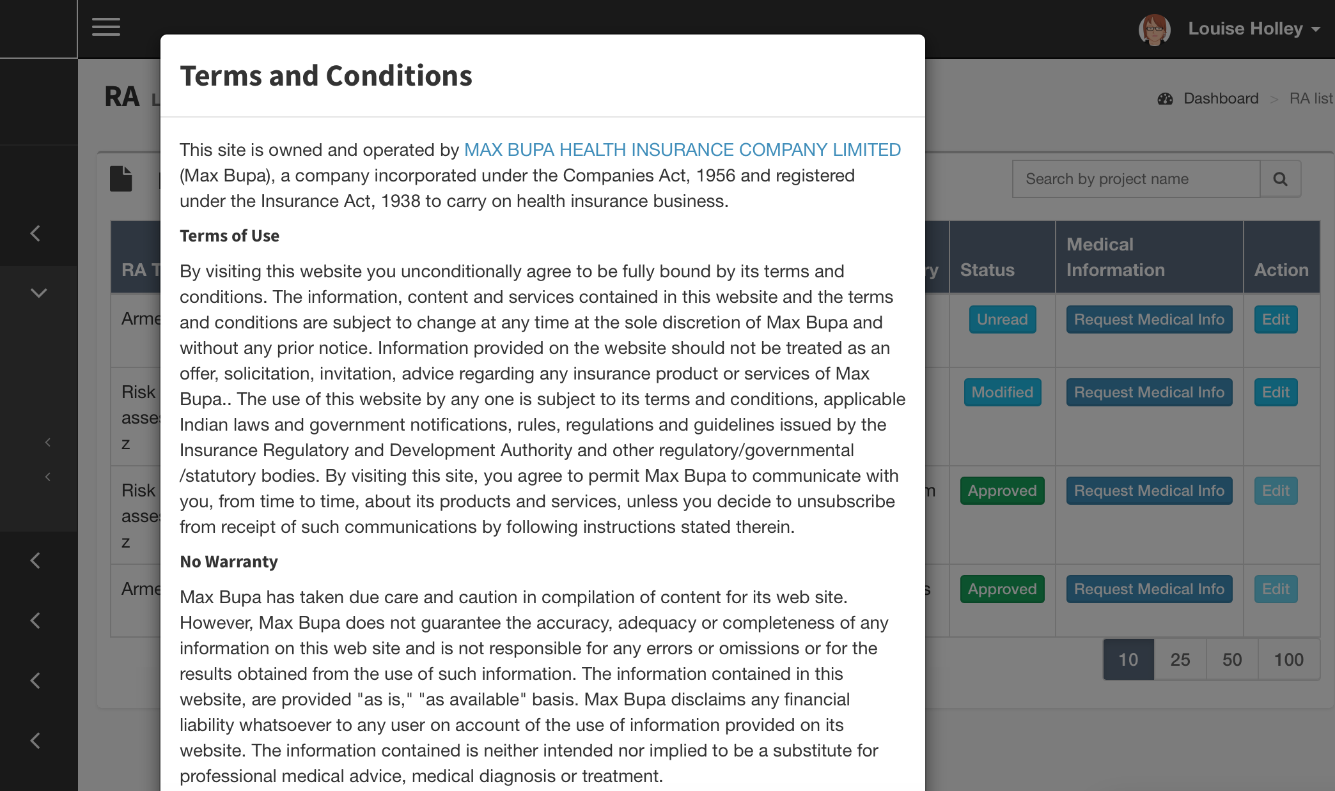
Other Bug: Request Medical Info – we need to remove this pop up and replace with notification saying “This feature is under development. Please contact your system administrator for medical information requests”

Slide 43
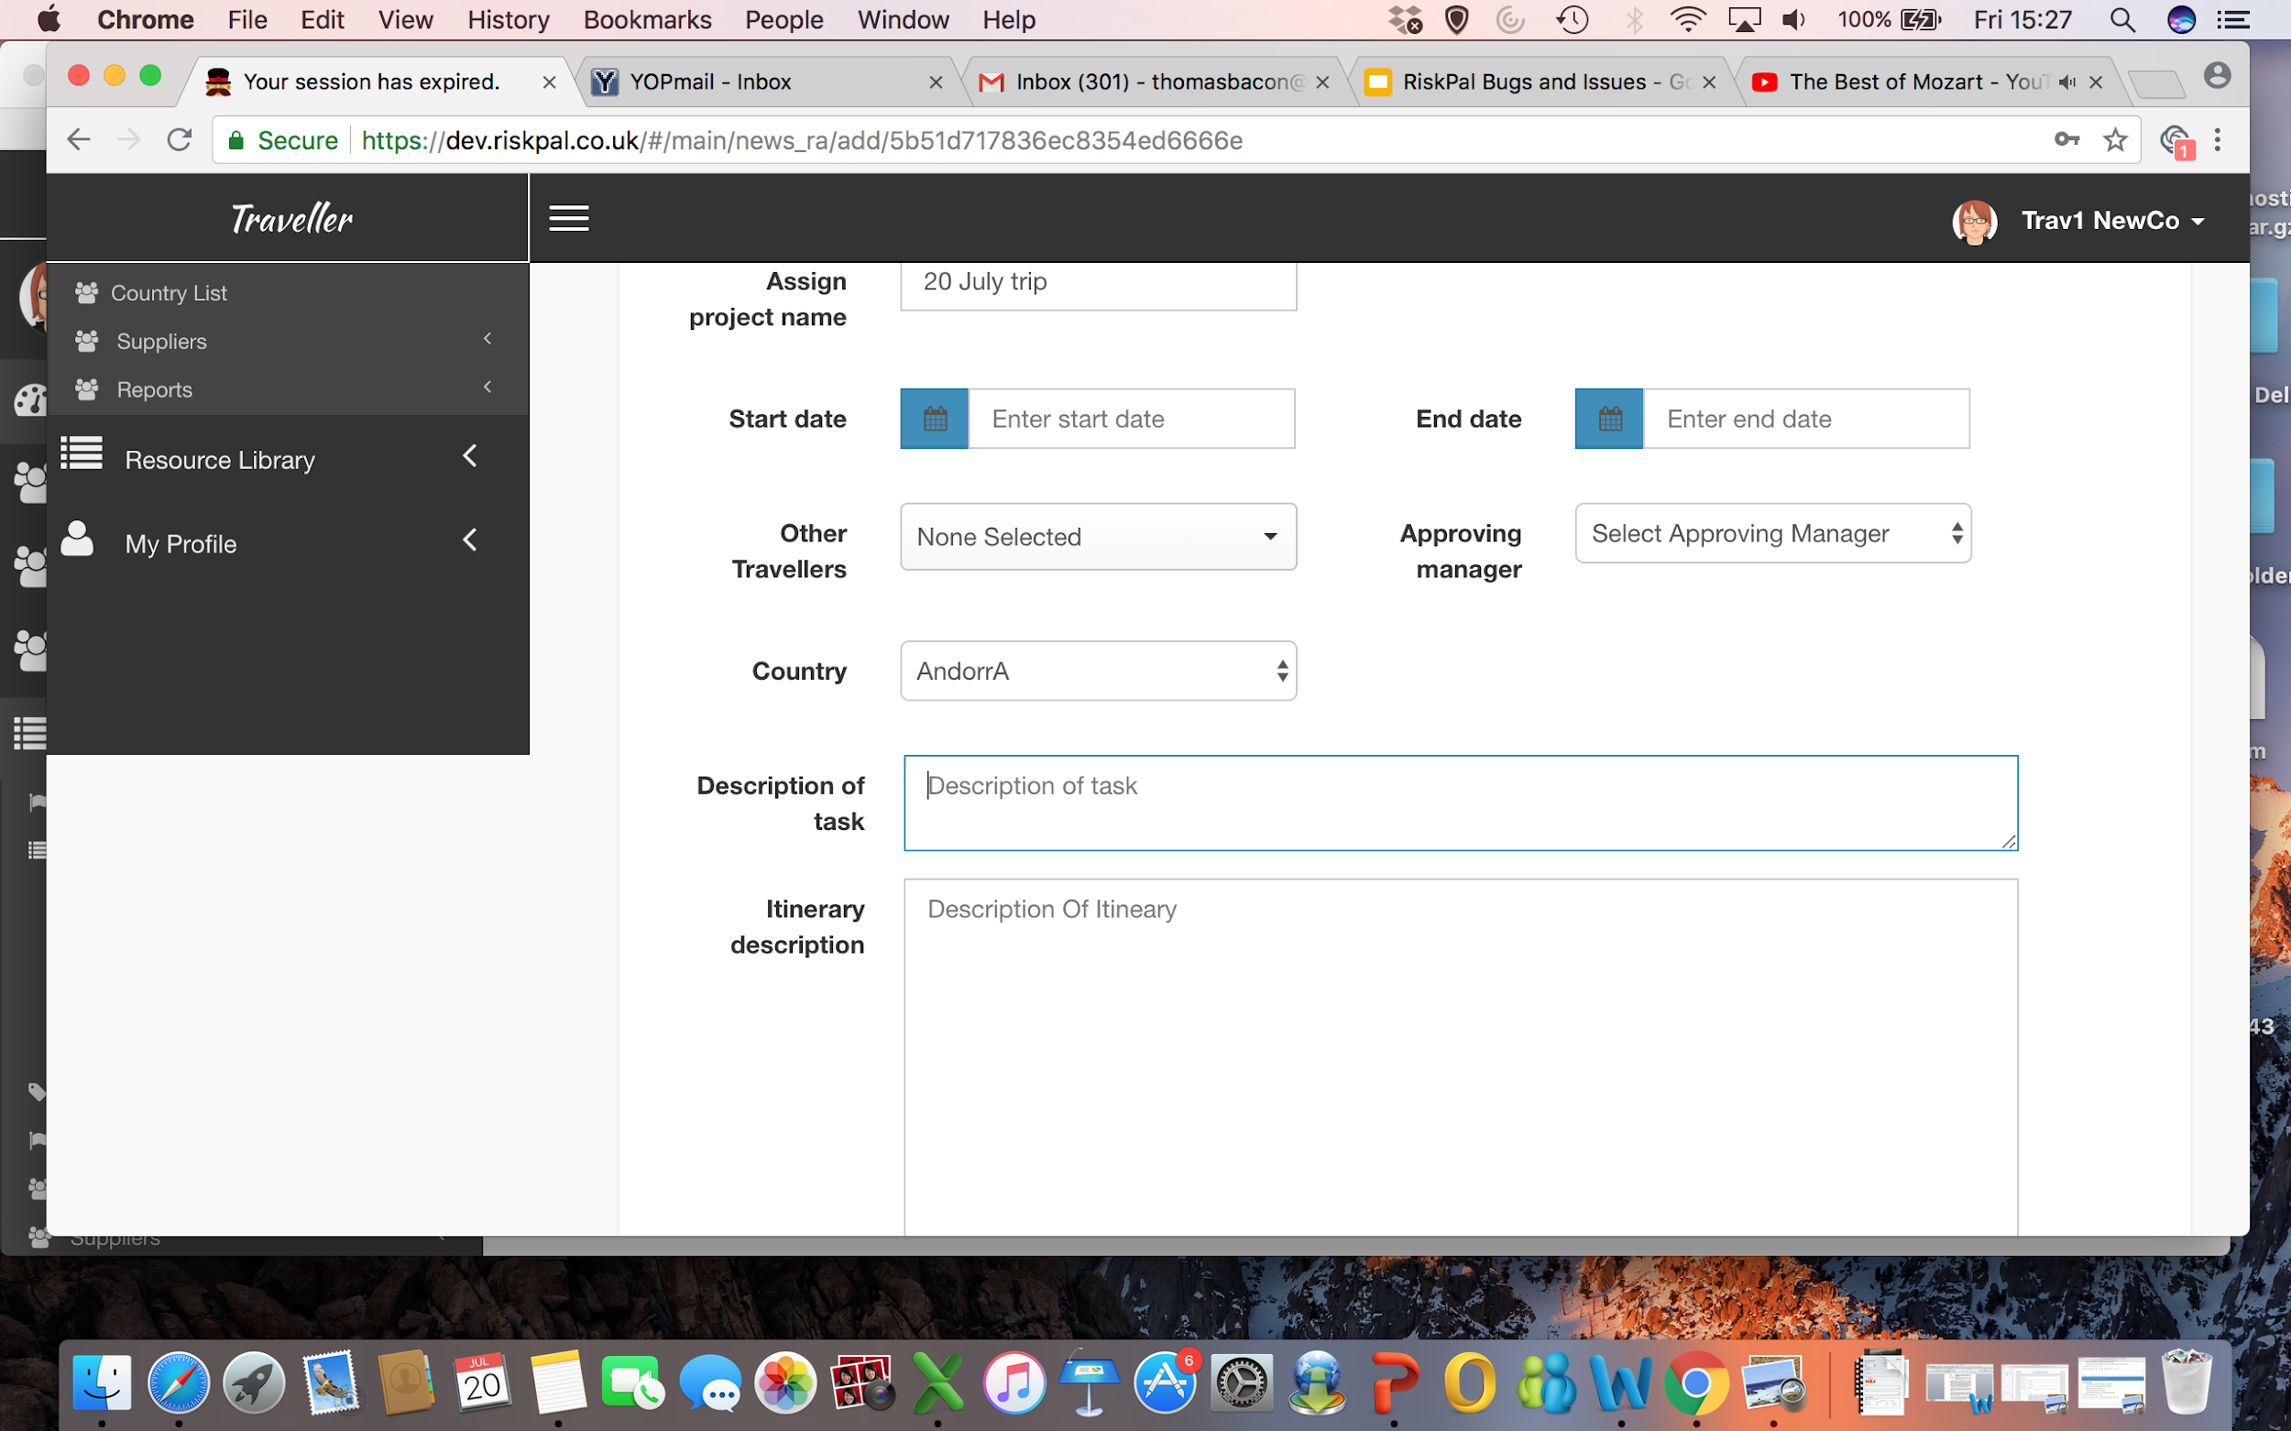
Oher Bug: Once a session expires and you log back in, the Your session has expired remains in the tab title.

